Slide 1
3rd Iteration
Client: Fred Sieling
Andres Almaraz and David Luis Hiraldo-Panchana

Slide 2
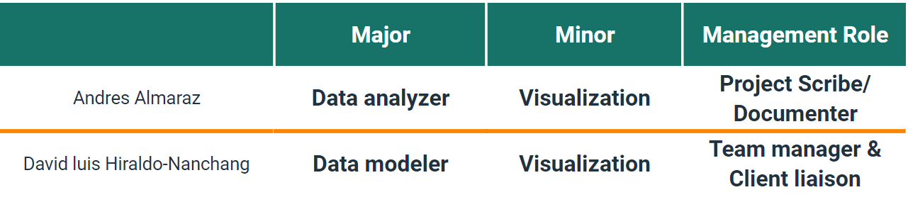
Roles

Slide 3
Brief Abstract
Our goal was to find trends that will allow us to find PFAS/Teflon in US and GA. The reasons being that it can cause serious health issues if entering a person's blood system. Since the chemical never fully goes away, it stays once anyone is exposed to it. So we want to be able indicate/reveal PFAS at any site to prevent harm and find the offenders causing it.

Slide 4








Technologies

Slide 5
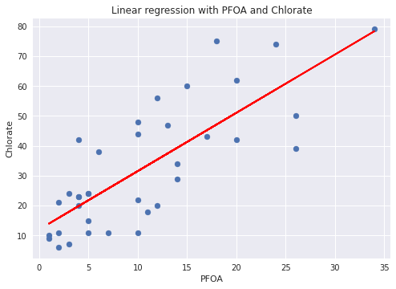
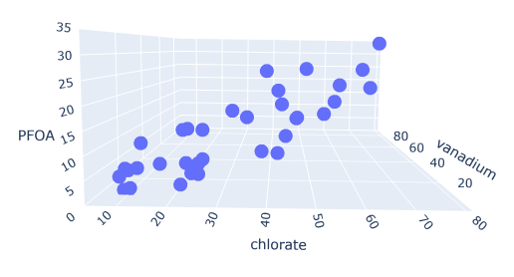
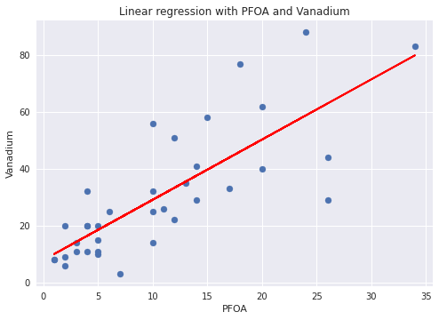
Is there a is an indicator that can be used in finding PFAS in the water?
Chlorate, Vanadium, Chromium-6 are indicators of PFOA which is a by product of Teflon

Slide 6
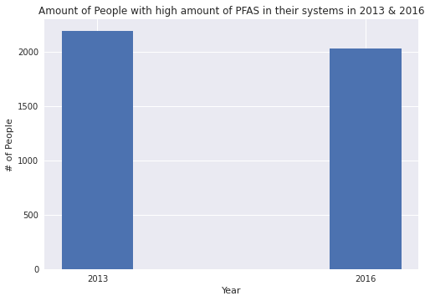
Are people getting more exposed to PFAS?
Difference is insignificant to draw an conclusion

Slide 7
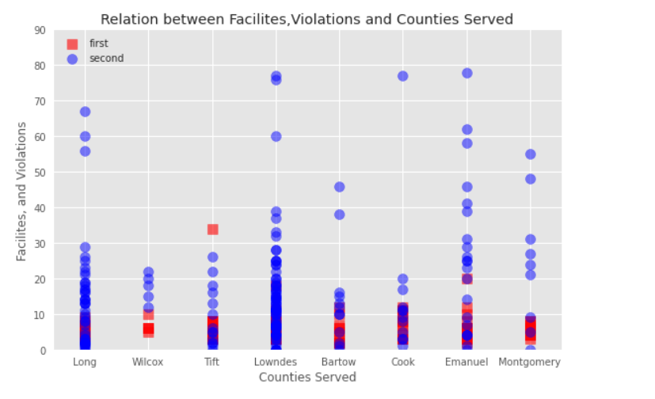
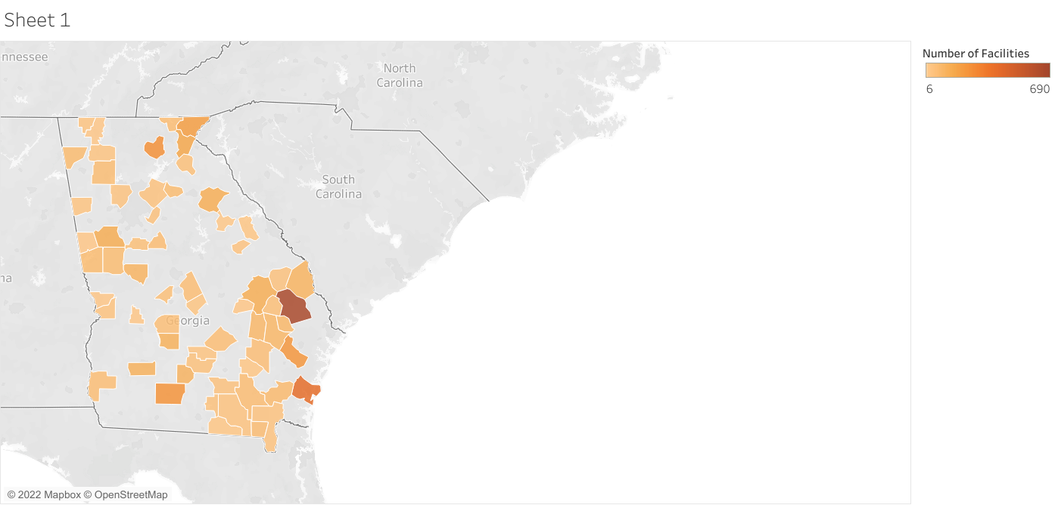
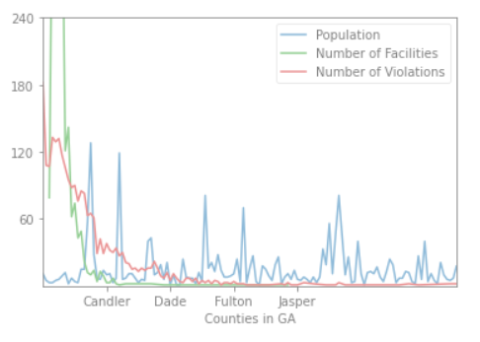
Is there a relationship between facilities, violations, and populations in Georgia?
There is a relationships between facilities, violations, and populations in Georgia: Lower populations equals more facilities

Slide 8
Extended Graphs

Slide 9
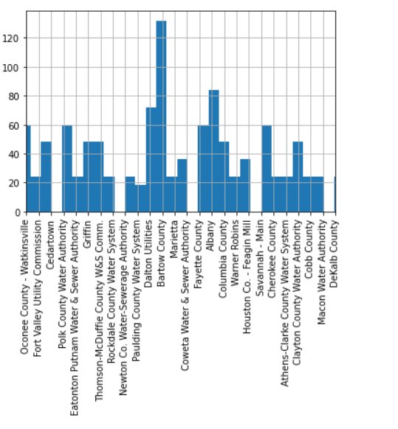
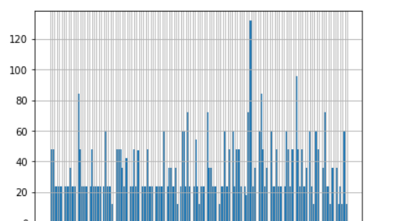
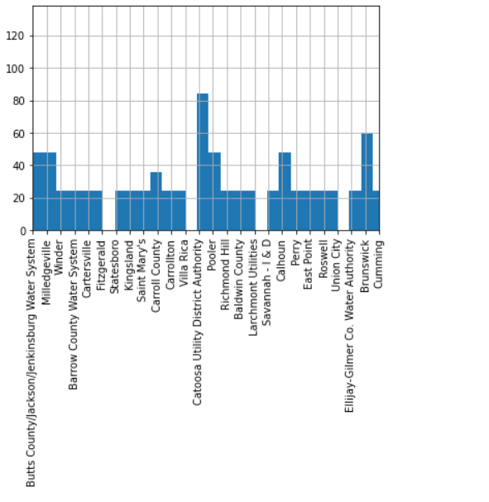
Where did PFAS occur most in Georgia in 2016?

Slide 10
Implemented
Only the first three hypothesis were implemented
Website with interactive map and information about PFAS that we learned
We implemented two algorithms being clustering and linear regression
Visualizations to support the hypothesis was done
Research on sites with PFAS and the cause at the time it happened

Slide 11
TO DO
Implement the fourth hypothesis.
Find current datasets to support our argument
Dig deeper into what the industries causing the issues produced
Could focus on other states and their counties as well to found out if they had any similarities to Georgia
Use more algorithms as well to predict future sights of PFAS using the correlations that were found

Slide 12
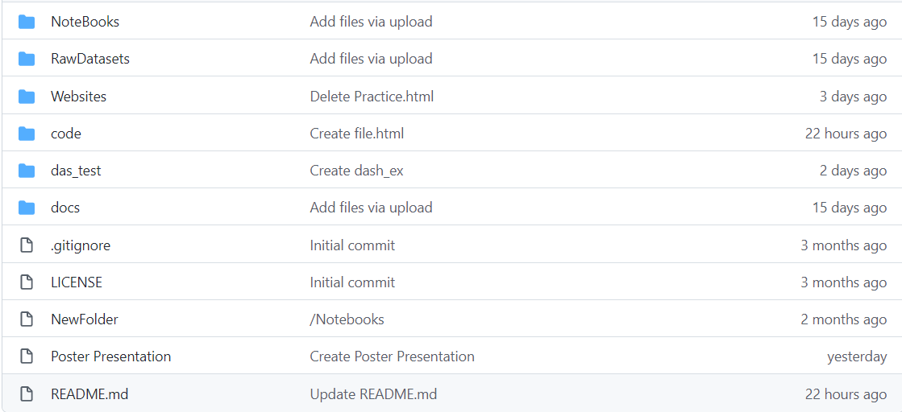
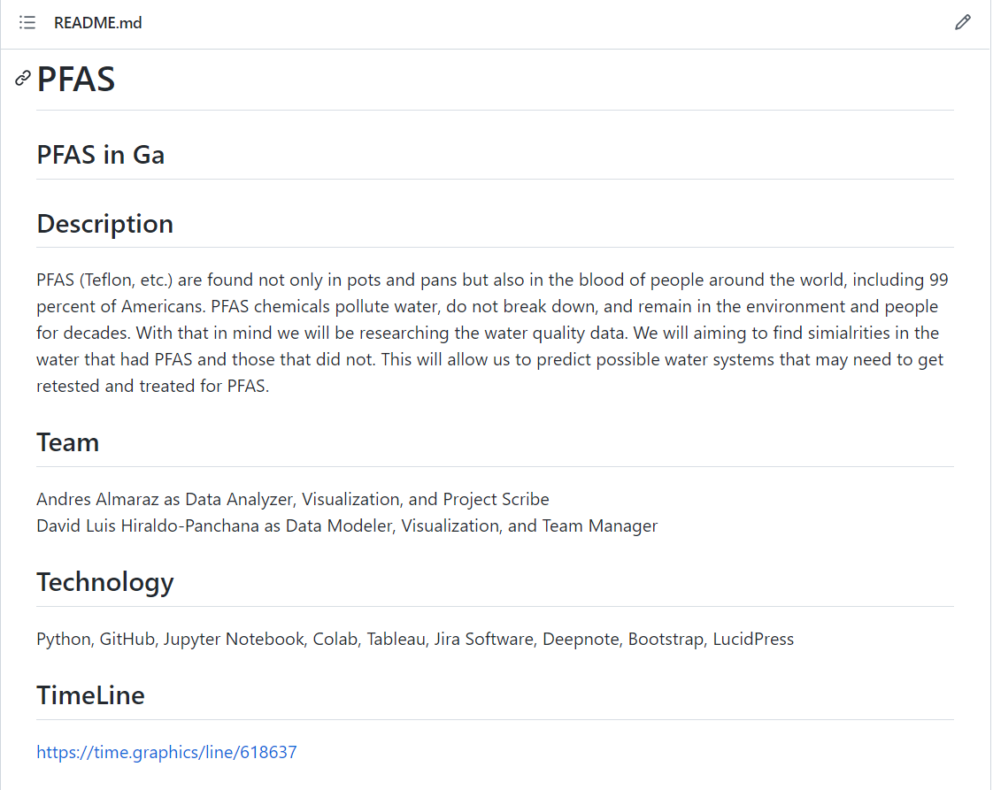
Github repo
Our updated Github, with all of information, link to website, documents, our notebooks and our datasets. The readme goes into more depth of our project and our purpose, our teams and some of the technologies we used.

Slide 13
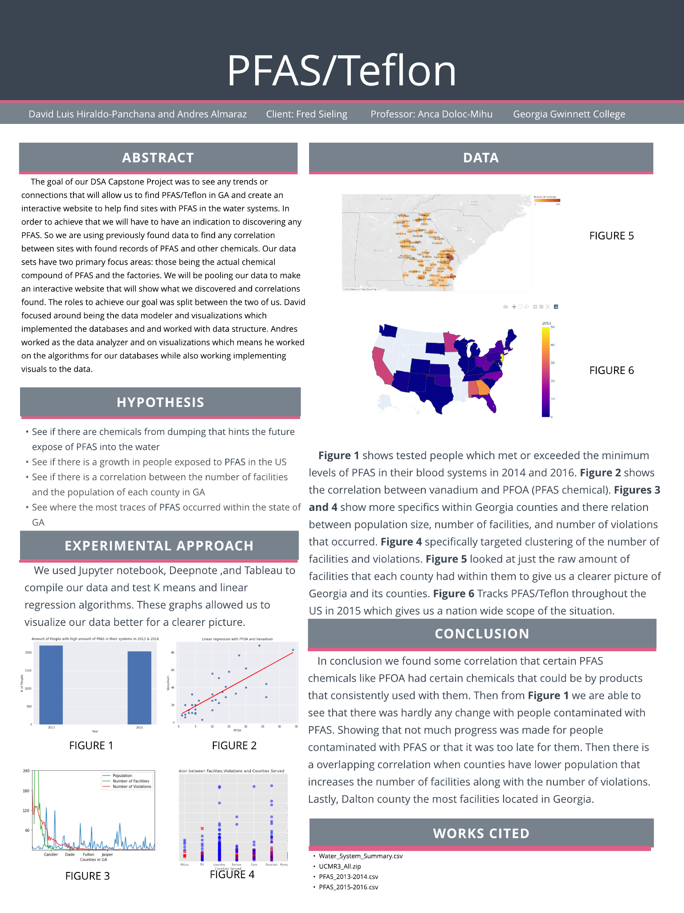
Poster

Slide 14
